Slide 1
IT Project Management
IT Project Management
Ing. Petra Pavlíčková, Ph.D.
2.Lecture – Organization structure of the project. Assembling project Team. Communication and project roles.
Ing. Petra Pavlíčková Ph.D.

Slide 2
Organizational structure
An organizational structure defines how activities such as task allocation, coordination and supervision are directed towards the achievement of organizational aims.
An organization can be structured in many different ways, depending on their objectives. The structure of an organization will determine the modes in which it operates and performs.

Slide 3
Organizational structure types
Pre-bureaucratic structures
Bureaucratic structures
Post-bureaucratic
Functional structure
Divisional structure
Matrix structure
Team

Slide 4
Functional structure
A functional organizational structure is a structure that consists of activities such as coordination, supervision and task allocation. The organizational structure determines how the organization performs or operates. The term organizational structure refers to how the people in an organization are grouped and to whom they report. One traditional way of organizing people is by function. Some common functions within an organization include production, marketing, human resources, and accounting.

Slide 5
Functional structure
This organizing of specialization leads to operational efficiencies where employees become specialists within their own realm of expertise. The most typical problem with a functional organizational structure is however that communication within the company can be rather rigid, making the organization slow and inflexible.

Slide 6
Divisional structure
The Divisional structure or product structure is a configuration of an organization, which breaks down the company into divisions that are self-contained. A division is self-contained and consists of a collections of functions which work to produce a product. It also utilizes a plan to compete and operate as a separate business or profit center.

Slide 7
Divisional structure
The advantage of divisional structure is that it uses delegated authority so the performance can be directly measured with each group.
Another advantage of using divisional structure is that it is more efficient in coordinating work between different divisions, and there is more flexibility to respond when there is a change in the market.
The disadvantages of the divisional structure is that it can support unhealthy rivalries among divisions. This type of structure may increase costs by requiring more qualified managers for each division.

Slide 8
Matrix structure
The matrix structure groups employees by both function and product. This structure can combine the best of both separate structures. A matrix organization frequently uses teams of employees to accomplish work, in order to take advantage of the strengths, as well as make up for the weaknesses, of functional and decentralized forms.

Slide 9
Matrix structure
Weak/Functional Matrix: A project manager with only limited authority is assigned to oversee the cross- functional aspects of the project. The functional managers maintain control over their resources and project areas.

Slide 10
Matrix structure
Balanced/Functional Matrix: A project manager is assigned to oversee the project. Power is shared equally between the project manager and the functional managers. It brings the best aspects of functional and projected organizations. However, this is the most difficult system to maintain as the sharing of power is a delicate proposition.

Slide 11
Matrix structure
Strong/Project Matrix: A project manager is primarily responsible for the project. Functional managers provide technical expertise and assign resources as needed.
Matrix management is more dynamic then functional management in that it is a combination of all the other structures and allows team members to share information more readily across task boundaries. It also allows for specialization that can increase depth of knowledge in a specific sector or segment.

Slide 12
Project-based organizational structure
Project organizational structure refers to the creation of an independent project team, the team’s management is separated from the parent organization’s other units, have their own technical staff and management, enterprise assigns certain resources to project team, and grant project manager of the largest free implementation of the project .

Slide 13
Team
One of the newest organizational structures developed in the 20th century is team. In small businesses, the team structure can define the entire organization. Teams can be both horizontal and vertical. While an organization is constituted as a set of people who synergize individual competencies to achieve newer dimensions.

Slide 14
Network
New network organizations contract out any business function, that can be done better or more cheaply.
In essence, managers in network structures spend most of their time coordinating and controlling external relations, usually by electronic means.

Slide 15
Virtual
The virtual organization exists within a network of alliances, using the Internet. This means while the core of the organization can be small but still the company can operate globally be a market leader.

Slide 16
Project team
A team is defined as “an interdependent collection of individuals who work together towards a common goal and who share responsibility for specific outcomes of their organizations”.
A project team is a team whose members usually belong to different groups, functions and are assigned to activities for the same project. A team can be divided into sub-teams according to need. Usually project teams are only used for a defined period of time.

Slide 17
Project team
Most project teams require involvement from more than one department, therefore most project teams can be classified as cross functional team. The project team usually consists of a variety of members often working under the direction of a project manager or a senior member of the organization.
Project teams need to have the right combination of skills, abilities and personality types to achieve collaborative tension.

Slide 18
Project Roles and Responsibilities
The Project Manager is the person responsible for ensuring that the Project Team completes the project.
The Project Manager develops the Project Plan with the team and manages the team’s performance of project tasks.
It is also the responsibility of the Project Manager to secure acceptance and approval of deliverables from the Project Sponsor and Stakeholders.
The Project Manager is responsible for communication, including status reporting, risk management, escalation of issues that cannot be resolved in the team, and, in general, making sure the project is delivered in budget, on schedule, and within scope.

Slide 19
Project Roles and Responsibilities
The Project Team Members are responsible for executing tasks and producing deliverables as outlined in the Project Plan and directed by the Project Manager, at whatever level of effort or participation has been defined for them.
On larger projects, some Project Team members may serve as Team Leads, providing task and technical leadership, and sometimes maintaining a portion of the project plan.

Slide 20
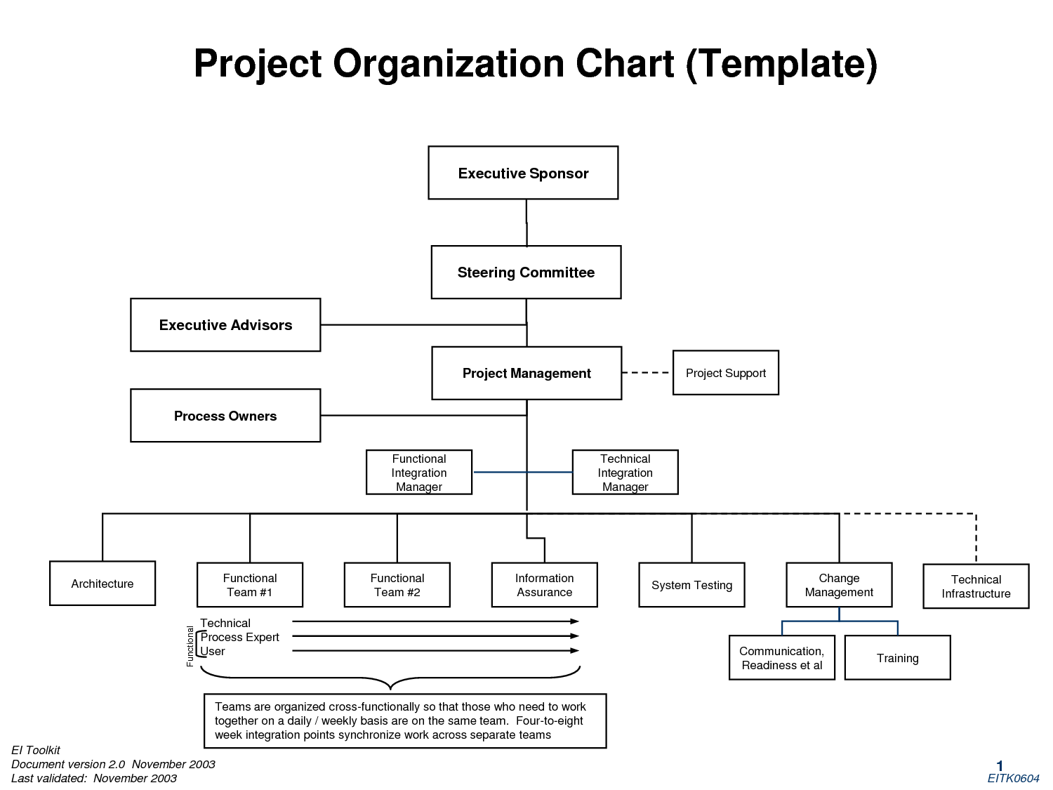

Slide 21
Executive Sponsor
is a manager with demonstrable interest in the outcome of the project who is ultimately responsible for securing spending authority and resources for the project. Ideally, the Executive Sponsor should be the highest-ranking manager possible, in proportion to the project size and scope.

Slide 22
Project Sponsor and/or Project Director
is a manager with demonstrable interest in the outcome of the project who is responsible for securing spending authority and resources for the project. The Project Sponsor acts as a vocal and visible champion, legitimizes the project’s goals and objectives, keeps abreast of major project activities, and is a decision-maker for the project.

Slide 23
Steering Committee
generally includes management representatives from the key organizations involved in the project oversight and control, and any other key stakeholder groups that have special interest in the outcome of the project. Generally they approve project deliverables, help resolve issues and policy decisions, approve scope changes, and provide direction and guidance to the project.

Slide 24
Customers
Customers comprise the business units that identified the need for the product or service the project will develop. Customers can be at all levels of an organization.
Customers to be directly involved in the project, the following roles are identified:
Customer Representatives are members of the Customer community who are identified and made available to the project for their subject matter expertise. Their responsibility is to accurately represent their business units’ needs to the Project Team, and to validate the deliverables that describe the product or service that the project will produce.

Slide 25
Customers
Customer Decision-Makers are those members of the Customer community who have been designated to make project decisions on behalf of major business units that will use, or will be affected by, the product or service the project will deliver. Customer Decision-Makers are responsible for achieving consensus of their business unit on project issues and outputs, and communicating it to the Project Manager.

Slide 26
Stakeholders
Stakeholders are all those groups, units, individuals, or organizations, internal or external to our organization, which are impacted by, or can impact, the outcomes of the project. This includes the Project Team, Sponsors, Steering Committee, Customers, and Customer co-workers who will be affected by the change in Customer work practices due to the new product or service.

Slide 27
Belbin Team Roles
The Belbin Team Inventory is a personality test, also called the Belbin Self-Perception Inventory.
the Belbin Inventory scores people on how strongly they express behavioural traits from nine different team roles. A person may and often does exhibit strong tendencies towards multiple roles.

Slide 28
Belbin Team Roles
Plant
Resource Investigator
Co-ordinator
Shaper
Monitor Evaluator
Teamworker
Implementer
Finisher
Specialist

Slide 29
List of references:
- Wikipedia (Project management)

